Slide 1
SOUVENIR CHILDREN FOUNDATION OF HAITI

Slide 2
SOUVENIR CHILDREN FOUNDATION STARTED IN 2009
ATTAINED 501( C )3 STATUS IN 2012

Slide 3
WHAT WE DO
CREATE OPPORTUNITIES FOR HAITIAN CHILDREN TO BUILD A PATH OUT OF POVERTY.
PROVIDE A CHRISTIAN BASED EDUCATIONAL FOUNDATION NECESSARY TO ACHIEVE SELF SUSTAINING DEVELOPMENT.
GET INVOLVED IN PROGRAMS THAT WILL HELP FAMILIES AND COMMUNITIES AS A WHOLE

Slide 4
IN 2021 THE POLITICAL INSTABILITY AND GANG ACTIVITY IN HAITI ESPECIALLY IN AND AROUND THE CAPITAL RESULTED IN THE CLOSING OF THE THREE SCHOOLS OUR FOUNDATION HAD SUPPORTED FOR YEARS.

Slide 5
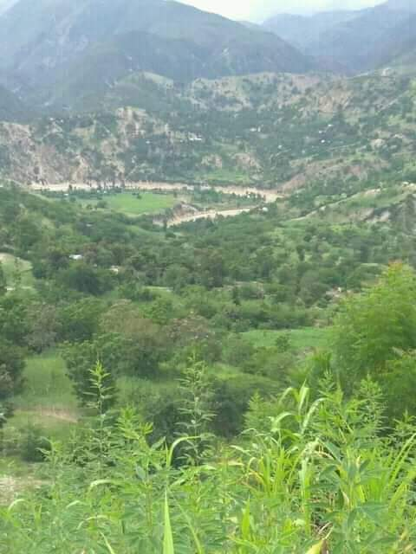
AN UNEXPECTED OPPORTUNITY PRESENTED TO OUR FOUNDATION TO SUPPORT A SCHOOL IN BELLE FOUNTAINE,AN EXTREMELY POOR AREA IN THE MOUNTAINS AWAY FROM THE TURMOIL IN THE CAPITAL.

Slide 6
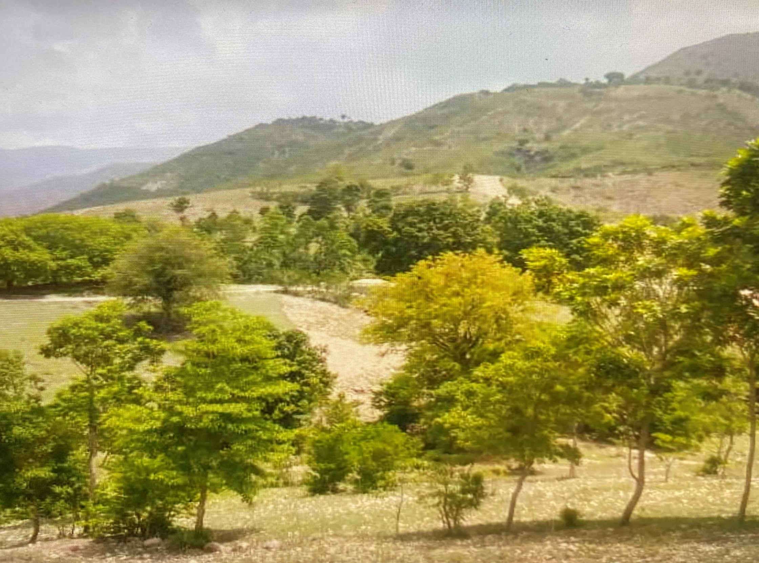

Slide 7
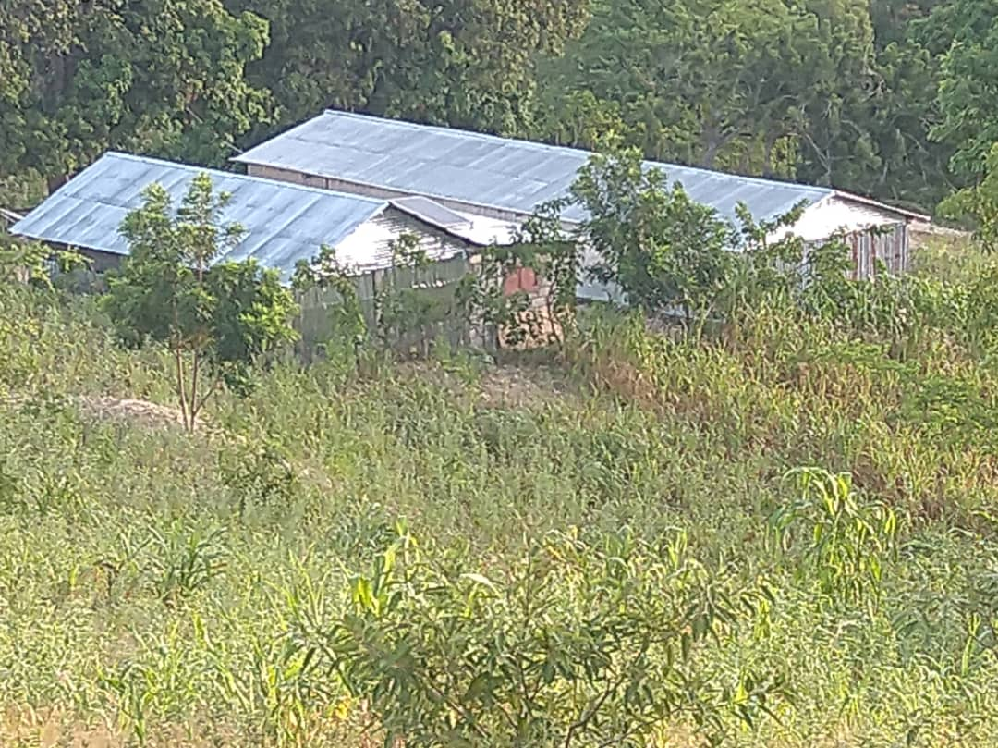
WE BUILT 2 TEMPORARY BUILDINGS OUT OF CORRUGATED TIN.
WE ARE ABOUT TO BUILD A 3RD BUILDING.

Slide 8
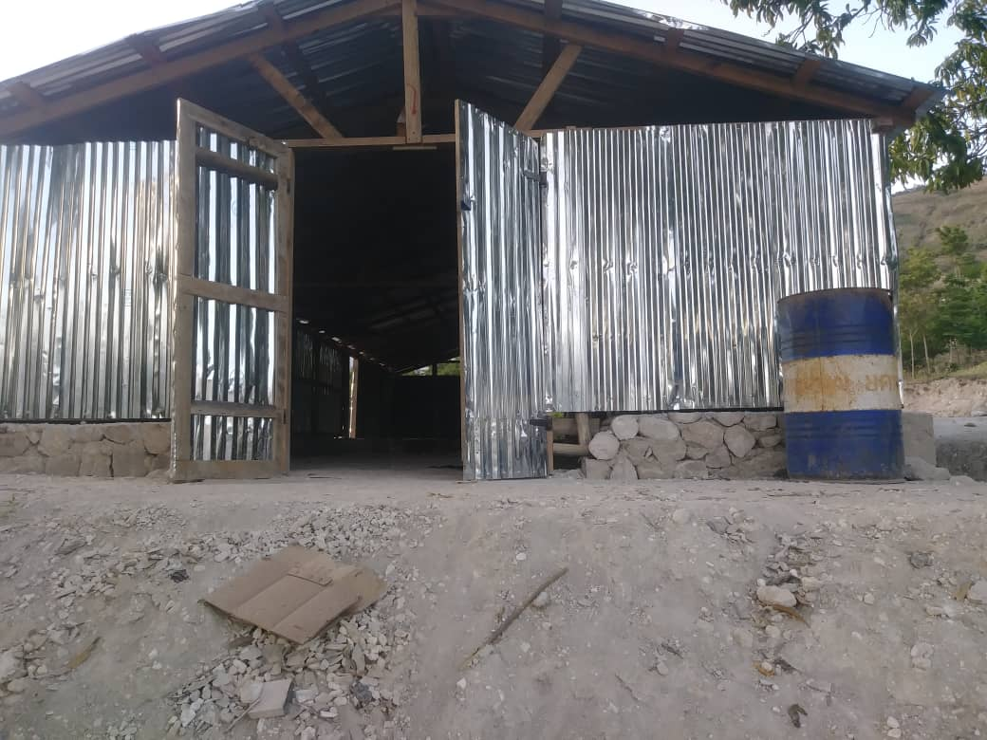

Slide 9
We want to build a permanent school building. Estimated cost $ 100.000.00

Slide 10
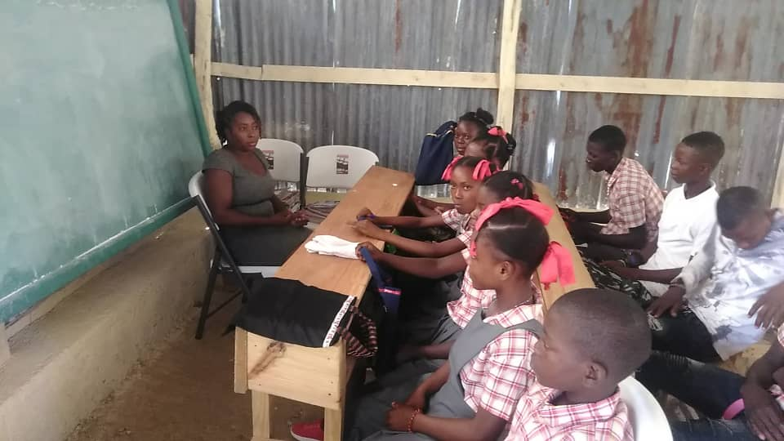
Currently 350 children are attending the school

Slide 11
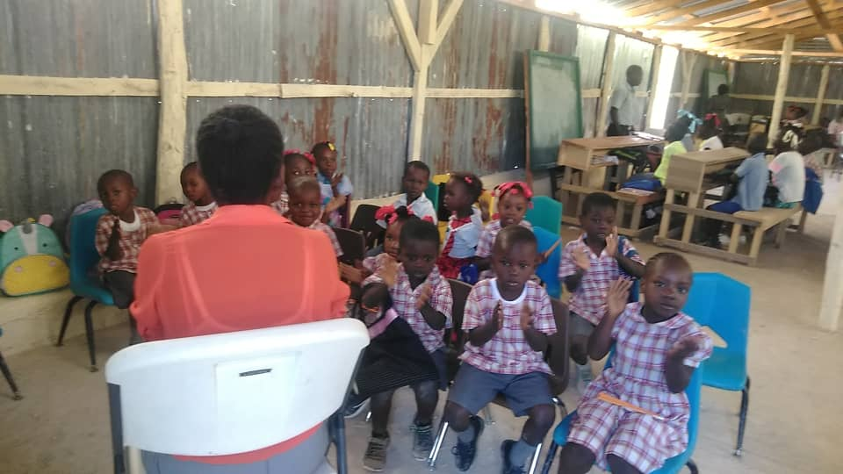

Slide 12
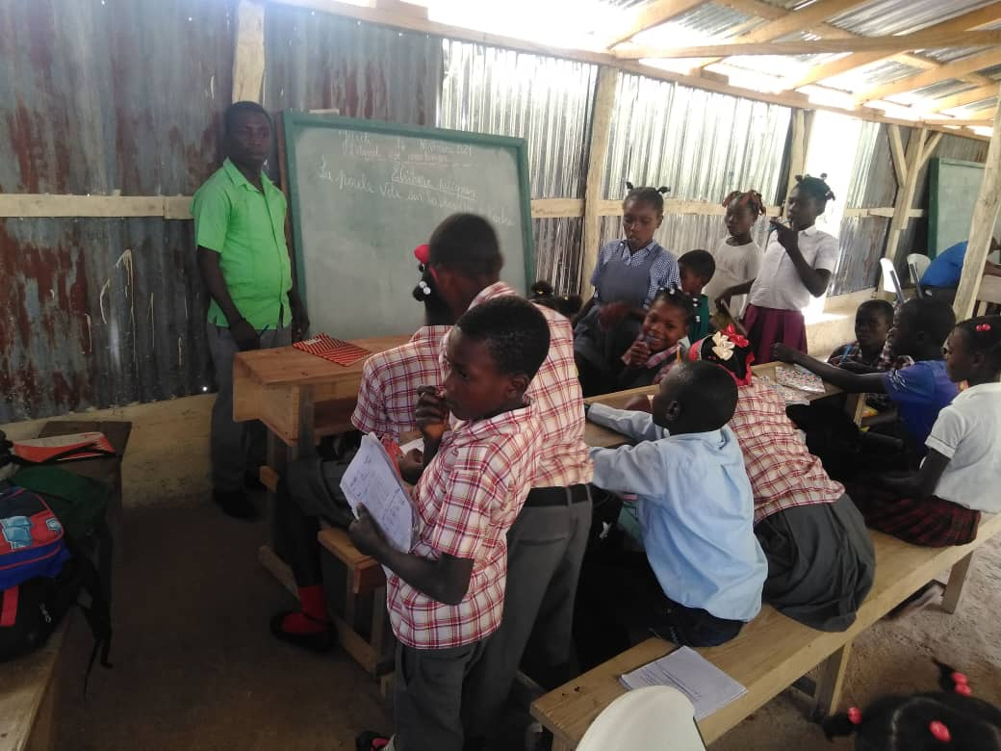

Slide 14
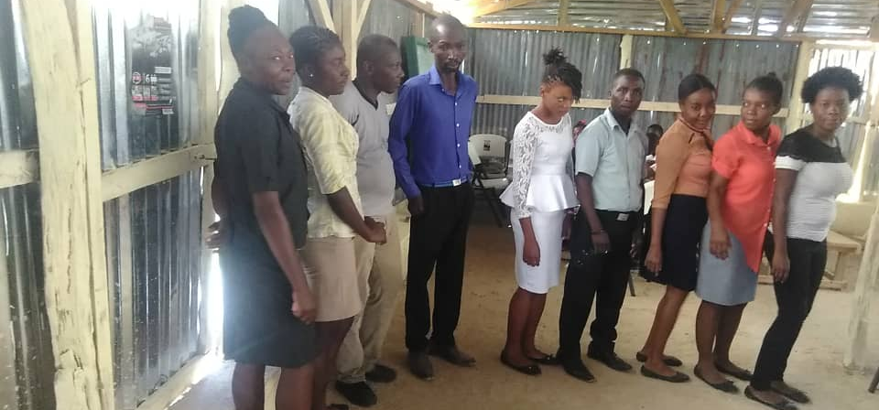
We have committed to pay the salaries of teachers
[$ 200.00/teacher],assistant principal $ 200.00/month and principal $ 300.00/month.

Slide 16
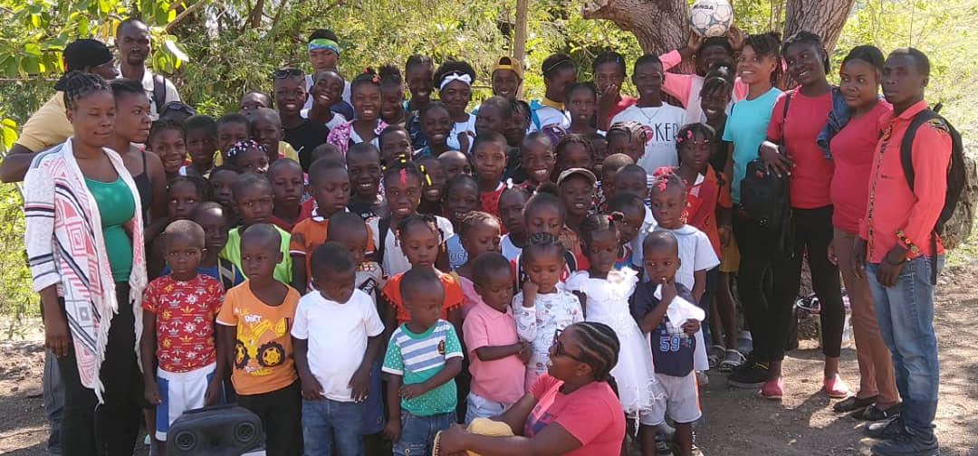

Slide 17
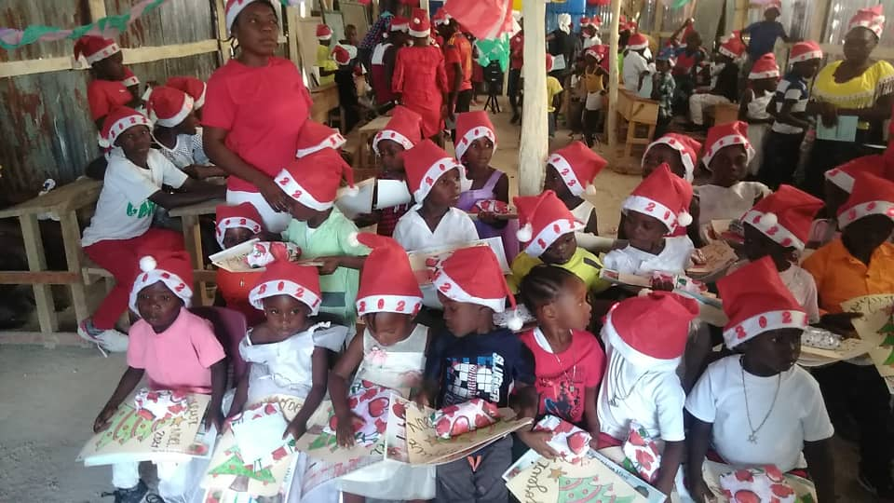

Slide 18
WE BUILT A 15,000 GALLON CISTERN TO COLLECT RAIN WATER AT A COST OF $ 10,000.00 TO MEET THE WATER NEEDS OF THE SCHOOL AND IMMEDIATE NEIGHBORHOOD.

Slide 19
WE STARTED A GOAT SHARING PROGRAM.IT HAS 30 GOATS SHARED AMONG 10 FAMILIES.MATURE GOATS ARE SOLD TO INCREASE FAMILIES INCOME.

Slide 20
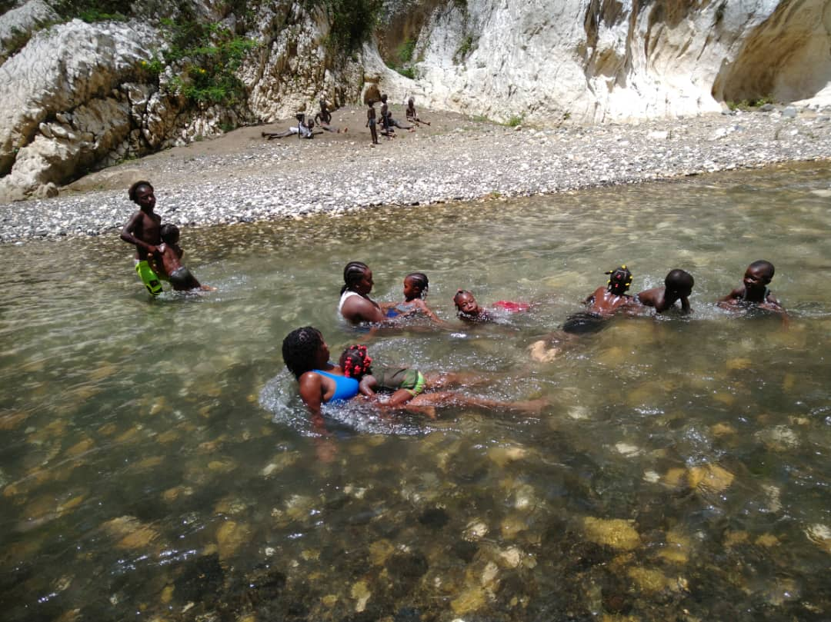
THIS YEAR WE SPONSORED SUMMER CAMPS AT 6 SITES INCLUDING BELLE FONTAINE.
CHILDREN HAD A GOOD TIME SWIMMING AT THE RIVER.

Slide 21
OVER THE YEARS SOUVENIR CHILDREN FOUNDATION HAS GIVEN SCHOLARSHIPS TO MANY DESERVING COLLEGE STUDENTS.
THIS YEAR WE HAVE GRANTED SCHOLARSHIPS TO A NURSING,A LAW AND THREE SEMINARY STUDENTS.

Slide 22
THIS YEAR THIRTY ADULTS COMPLETED THE ALPHABETISATION PROGRAM AND ARE NOW ABLE TO READ AND WRITE.

Slide 23
WE ARE HOPEFUL THE POLITICAL SITUATION WILL IMPROVE SO THE THREE OTHER SCHOOL CAN REOPEN.
IN 2016 DR TANIA LOZANO,HER HUSBAND DR MICHAEL LOZANO, THEIR DAUGHTER VICKY, EUNICE LABORDE AND DR JOEL LABORDE VISITED THE TWO THRIVING SCHOOLS IN THE CAPITAL.

Slide 24
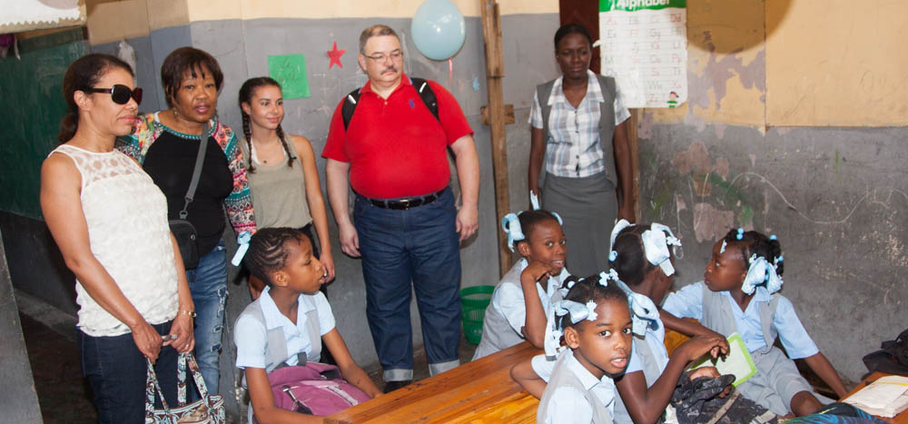

Slide 25
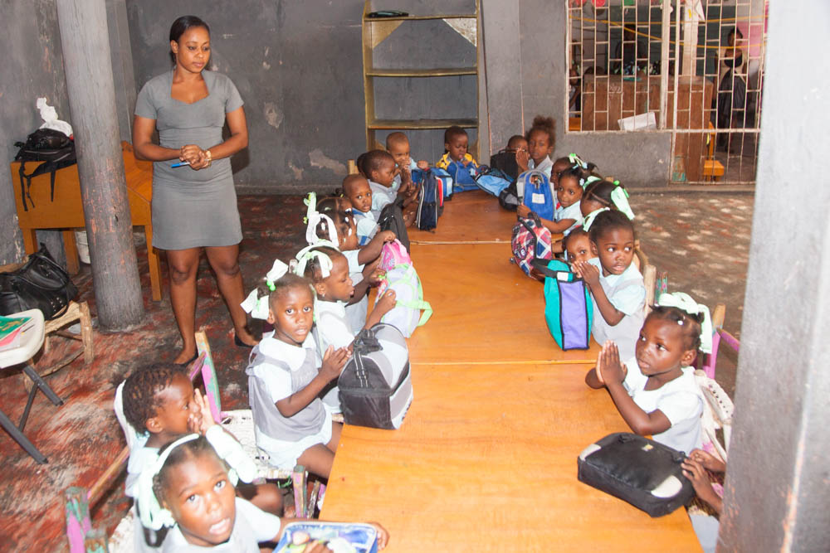

Slide 26
IN 2021 A DEVASTATING EARTHQUAKE HIT THE SOUTHERN PART OF HAITI.
OVER 2000 PEOPLE DIED AND COUNTLESS LOST HOME AND BUSINESSES.
SOUVENIR CHILDREN FOUNDATION SENT TRUCK LOADS OF FOOD ITEMS.
ALSO SENT ITEMS OF CLOTHING,TOILETERIES,TOOLS,TENTS.
SOUVENIR CHILDREN FOUNDATION ASSISTED IN THE CONSTRUCTION AND REPAIR OF HOMES.

Slide 30
PLEASE CONTINUE TO HELP US.WE COUNT ON YOUR GENEROUS SUPPORT FOR US TO KEEP MAKING A DIFFERENCE IN THE LIVES OF THE PEOPLE OF HAITI.
SCFHAITI.ORG

Slide 31
